Slide 1
CSE 6324 Advanced Topics in Software Engineering
By Team 8:
SAI NIKHIL KANCHUKATLA(1002034488)
SAMPATH KUMAR MEDIPUDI(1002032901)
SAI KRISHNAM RAJU BHUPATHIRAJU(1002019782)
FARAZ SHAIK AHMAR(1002035224)

Slide 2
Issue #981: Lack of checks by missing-zero-check detector in parent contract's constructor[8]
“missing-zero-check” detector doesn't seem to check the arguments for constructor of parent contracts.
Even if the parent contract's constructor has zero-access checks & the child contract is using the same variable, it's gets flagged. [8]
Copy-paste from github[8]

Slide 3
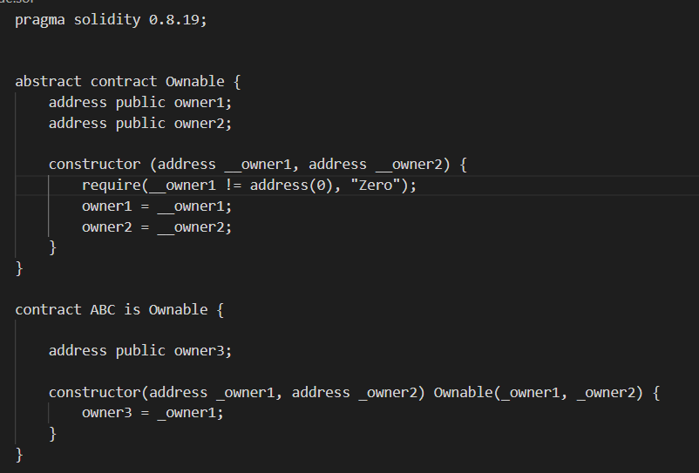
Code:
Figure [https://github.com/crytic/slither/issues/981]

Slide 4
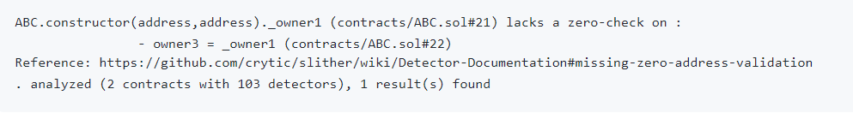
Output
Figure [https://github.com/crytic/slither/issues/981]

Slide 5
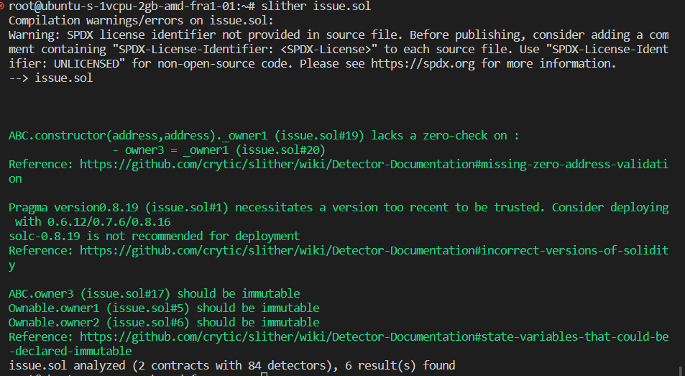

Slide 6
Understanding the Missing check detector??
Below are the Functions of the Detector :
_zero_address_validation_in_modifier:
_zero_address_validation:
_detect_missing_zero_address_validation:
_detect:

Slide 7
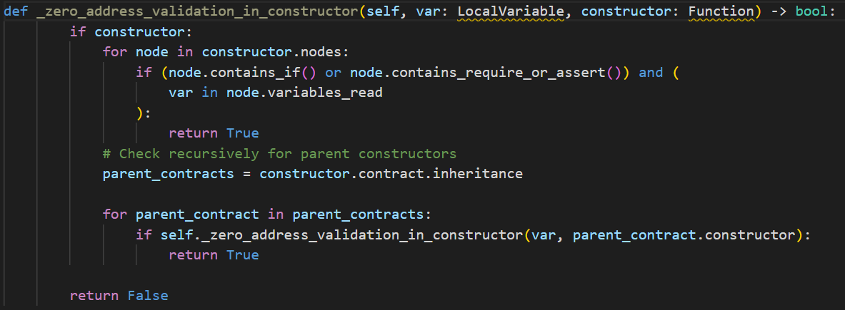
[ FIX ]

Slide 8
Checking for Validation
The function first checks if a constructor function is provided, otherwise it returns False.It then iterates over all the nodes in the constructor function.For each node, it checks if the node contains an if statement or a require or assert function call that uses the variable var.
Recursive Check
If the variable is not found to be zero address validated in the current constructor, the function checks recursively for parent constructors.It retrieves the parent contracts of the current constructor and iterates over them.For each parent contract, it calls the _zero_address_validation_in_constructor function again, passing the same var variable and the parent constructor as parameters.

Slide 9
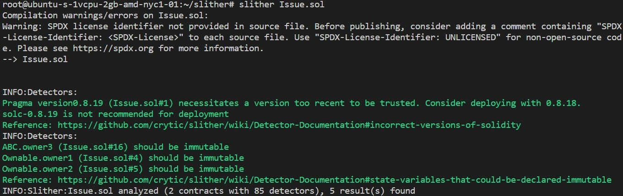
Issue got Resolved

Slide 10
Risk Estimation
Risks | Type | Feasible Solution
During the final presentation, It would be hard to arranging/aligning the risks that stimulating vulnerabilities | Minor. | addressing the main vulnerabilities that required for detector in parent contract's constructor
It would be challenging to adjust to differences in the norms and structures of each domain's smart contract, and the complexity might keep rising with each iteration. | Major. | It is recommended that each person work on different modules of the project. To prevent for overriding same content by others without overlapping
Estimated completion time for all targeted vulnerabilities | Minor. | So far we are near to close the issue in this iteration and solve the issue and contribute our code to development team

Slide 11
End Users/Customers
Egan Lobo(Solidity Beginner): It’s great to observe that team has achieved their goals by resolving the project. I would like to take the moment to appreciate each person in the team for their continues contribution.
Narendra Mareddy (Junior Developer in Ethereum): The Logic used my team is accurate in resolving this issue in proper way on time, also I can see the design & functionality understandable for future users who read it.

Slide 12
Github link
https://github.com/Sampath2901/6324-Project#6324-project

Slide 13

References
[1] https://www.visual-paradigm.com/guide/uml-unified-modeling-language/what-is-use-case-diagram/ [04/03/2023]
[2] https://doi.org/10.48550/arXiv.1908.09878 [04/03/2023]
[3] https://doi.org/10.48550/arXiv.1809.02702 [04/03/2023]
[4] https://github.com/crytic/slither [04/03/2023]
[5] https://blog.trailofbits.com/2018/10/19/slither-a-solidity-static-analysis-framework/ [04/03/2023]
[6] https://medium.com/coinmonks/automated-smart-contract-security-review-with-slither-1834e9613b01 [04/03/2023]
[7] https://www.linkedin.com/pulse/how-secure-smart-contracts-slither-damilare-d-fagbemi/?trk=pulse-article_more-articles_related-content-card [04/03/2023]
[8] https://github.com/crytic/slither/issues/981 [04/03/2023]
[9] https://app.diagrams.net/ [04/03/2023]

Slide 14
References
[10] https://www.h-x.technology/blog/top-3-smart-contract-audit-tools [04/03/2023]
[11] https://doi.org/10.48550/arXiv.1908.09878 [04/03/2023]
[12] https://doi.org/10.48550/arXiv.1809.02702 [04/03/2023]
[13] https://blog.trailofbits.com/2019/05/27/slither-the-leading-static-analyzer-for-smart-contracts/ [04/03/2023]
[14] https://github.com/crytic/slither#features [04/03/2023]
[15] https://www.sciencedirect.com/topics/computer-science/inheritance-hierarchy [04/03/2023]

Slide 15

Thank You

